Slide 1
Human Resources
Consultancy & Services
By: CENTRICK LO YEW CHUNG
TEH JUN KEAT
LOKE WEI JIAN
1

Slide 2
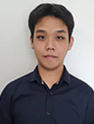
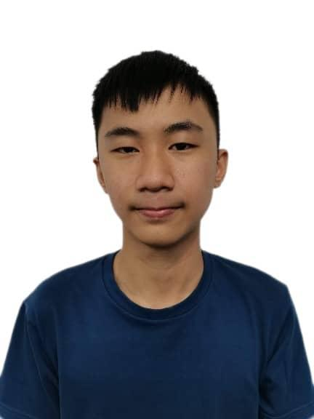
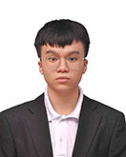
Our Team
Centrick Lo Yew Chung
Teh Jun Keat
Loke Wei Jian
We Are Doing The System Of HR Consultancy & Services
WE Hope this system would be a lot of help to this community
2

Slide 3
Content
Cover Page ----------------- 1
Our Team --------------------- 2
Content ------------------------3
Introduction -------------------4
Problem Statement-----------5-9
Objectives ---------------------10-14
Function & Usability ----------15-18
Project Scope -------------------19-22
Flowchart -----------------------23-26
Gantt Chart----------------------27-29
Demonstration------------------30
Conclusions---------------------31
QNA-------------------------------32 -
3

Slide 4

Introduction
In the dynamic business landscape of 2023, where challenges abound and organizational success is diverse, deficiencies in management structures often eclipse core operational strengths. This PowerPoint advocates for a dedicated Human Resources (HR) outsourcing system, specifically tailored for companies lacking an internal HR department.
By prioritizing optimized workforce dynamics, employee well-being, and organizational resilience, this initiative seeks to address root causes of dilemmas. Through professional HR services, organizations can fortify operational foundations, fostering a thriving and resilient organizational culture.
4

Slide 5
Problem Statement
Dichotomy in Business Success:
1
Some companies achieve listed status while others face financial instability and bankruptcy threats.
Root causes often link to deficiencies in management structures rather than core operational flaws.
5

Slide 6
Problem Statement
2
Role of Management Structures:
Challenges stem from deficiencies within management structures.
The absence of a dedicated HR department compounds issues.
6

Slide 7
Problem Statement
3
Critical Lack of HR Mechanism:
Lack of a dedicated HR department leaves companies without a vital mechanism for comprehensive personnel management.
Effective personnel management is crucial for success in the modern business landscape.
7

Slide 8
Problem Statement
4
Manifested Challenges:
Suboptimal workforce dynamics.
Inadequate attention to employee well-being.
Lack of resilience within organizational culture.
8

Slide 9
Problem Statement
5
Proposal for HR Outsourcing:
Advocacy for the implementation of a tailored HR outsourcing system.
Specifically designed to meet the unique needs of companies lacking an internal HR department.
9

Slide 10

Objectives
Establish a Specialized HR Outsourcing System
Make a special system for handling HR tasks that fits the specific needs of companies without their own HR department. Put this system into action.
10

Slide 11
Objectives
Optimize Workforce Dynamics
Improve the efficiency and effectiveness of workforce dynamics within client organizations, focusing on talent acquisition, retention, and development.
11

Slide 12
Objectives
Prioritize Employee Well-being
Implement strategies and programmed that prioritise the well-being and satisfaction of employees, fostering a positive and conducive workplace culture.
12

Slide 13
Objectives
Enhance Organizational Resilience
Strengthen the organizational resilience of client companies by providing comprehensive personnel management services, enabling them to adapt to challenges and changes in the business environment.
13

Slide 14
Objectives
Provide Professional HR Services
Deliver high-quality HR services, including but not limited to employee relations, performance management, and compliance, to ensure that client organizations meet industry standards and legal requirements.
14

Slide 15
Function & Usability
Company User
01
User Registration
Forget password
Approve, disapprove and reapprove
Contact form
Survey form submits
The notification in email or Gmail
Login function
The Api for the WhatsApp, Facebook and Instagram
Change Password
Subscribe and unsubscribe function
Payroll System

Slide 16
Function & Usability
02
Admin
Analysis chart of the people counts
The table showing the respond of the user
Login function
The unsubscribed feedback form feedback in the panel
The testimonial video in the admin panel site
Logout function

Slide 17
Function & Usability
03
Worker
Upload the survey form for the user can answer the survey form and result show in super admin
Upload the information of the worker that let the user to approve if they want
The send notification on sending verification code to email or Gmail for the user to change the password

Slide 18
Function & Usability
04
Client_Worker
Client worker can login their account to apply the leave, the three leave to let client worker applying , got the sick leave , unpaid leave and time off leave.

Slide 19

Project Scope
01
Admin
Login Interface: Login the admin information into admin panel
Admin panel: Have the result after the company submitted
Admin home: Have the graph show the status of it and the testimonials video to view
Admin home unsubscribed: Show the feedback result after unsubscribed
Admin Panel : Got the table to display about the system user, worker , and worker status info table

Slide 20
Project Scope
02
Worker
Login Interface: Login the worker information into worker panel
Upload worker: Upload the worker information for the user to approve or disapprove
Upload survey: Upload the survey form for the user to answer
Logout function: logout to the front page and ready for next login
Help Client to register their worker infomation to let the client worker login

Slide 21
Project Scope
03
Company User
Company Registration: Create registration information for login
User Login: Login the company information to the user index
Unsubscribe button: when pressed the unsubscribed then it will come out a feedback form and show the feedback form for the user to feedback and delete the user information
Upload or change the profile picture: Change the profile picture or insert the profile picture
User Dashboard: Show the uploaded worker for them to approve or disapprove or reapprove
User Dashboard: Show the Survey form for the user to answer and submit and transform into pdf.
Logout function: logout to the login page and ready for next login
Got the payroll System to help user count the worker salary and the automatic subtract the EPF and SOSO

Slide 22
Project Scope
04
Company User Worker
Company User Login: Login the username and password to the dashboard and logout function
Leave system : got the sick leave , unpaid leave and time off leave
View leave history : got the table to display the leave history

Slide 23
Admin
Flowchart

Slide 24
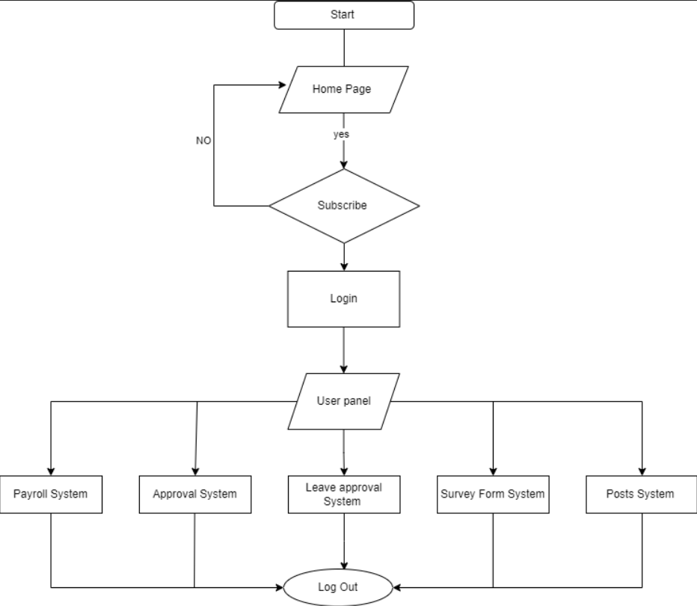
Company
User
Flowchart

Slide 25
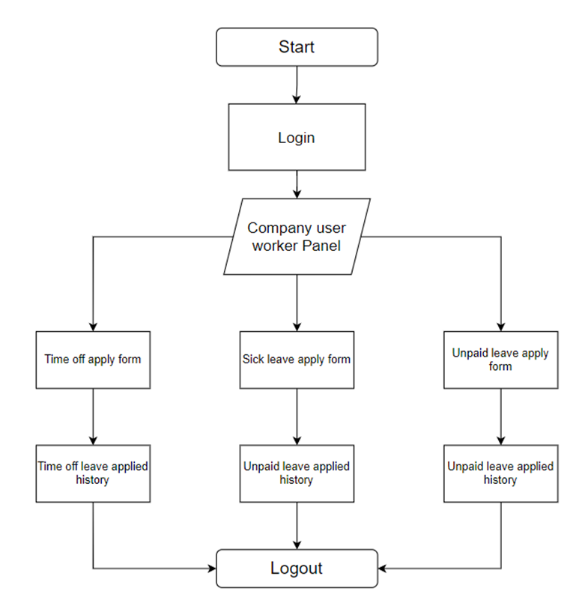
Company
User
Worker
Flowchart

Slide 26
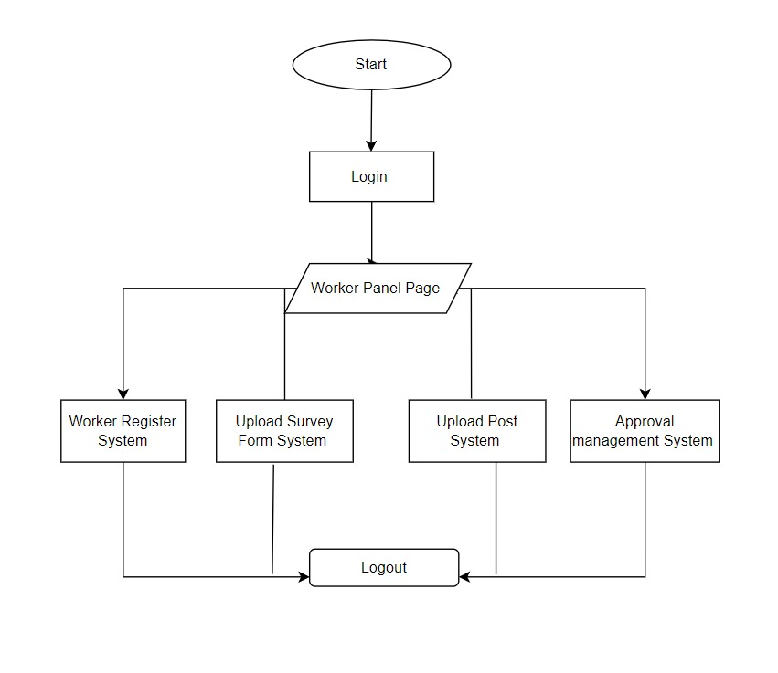
Worker
Flowchart

Slide 27

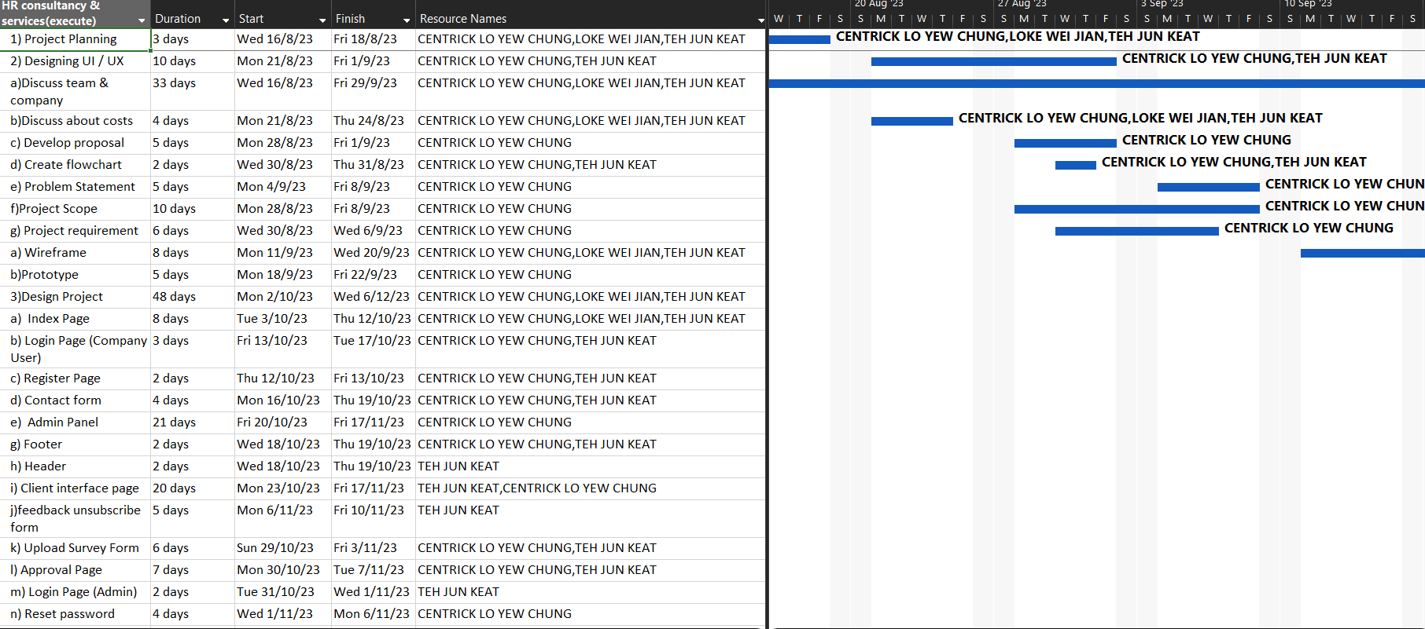
Gantt Chart (execute)

Slide 28
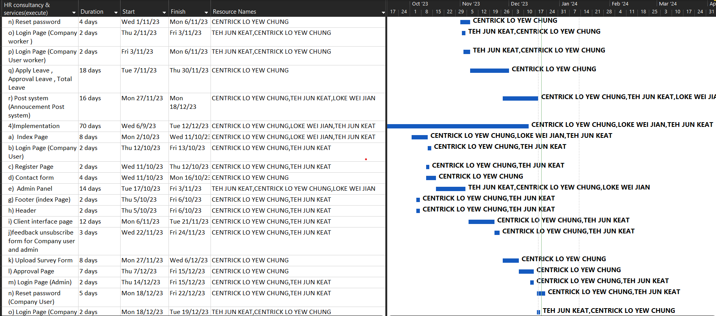
Gantt Chart (execute)

Slide 29
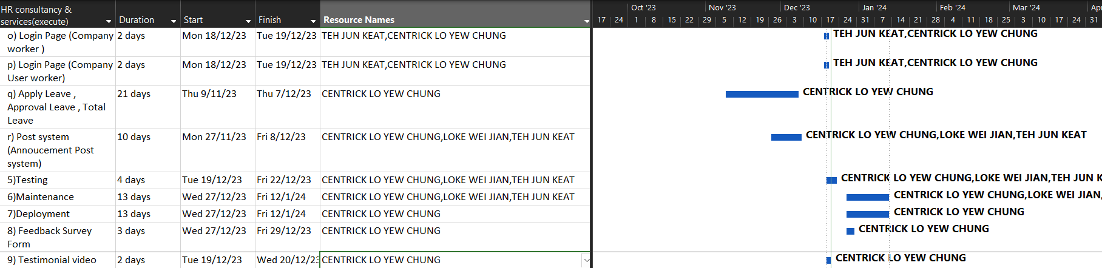
Gantt Chart (execute)

Slide 30
Demonstration

Slide 31

Conclusion
Strategic Alignment: The proposed HR
outsourcing system strategically aligns with
the complexities of contemporary business challenges
in 2023.
Holistic Success: Acknowledges that success extends beyond core operations, emphasizing the pivotal role of human capital management.
Tailored Solutions: Tailored for companies lacking internal HR departments, offering tangible solutions to enhance workforce dynamics, prioritize well-being, and fortify resilience.
Call to Action: Embrace the transformative potential of HR outsourcing for a future-ready and thriving organizational journey.

Slide 32
QNA

Slide 33
THANK YOU
Have a nice day

